Slide 1

Asthma disease
Visualization & ml project
By : C.A. Arifa

Slide 2
introduction
• Asthma is a chronic inflammatory disease that affects the airways of the lungs. • It can occur in people of all age groups, including children and adults. • Asthma is characterized by repeated episodes of wheezing, shortness of breath, chest tightness, and coughing. • These symptoms may become worse due to triggers such as dust, smoke, pollen, pollution, cold air, or physical activity. • Both genetic factors and environmental conditions play an important role in the development of asthma. • Although asthma cannot be completely cured, it can be effectively managed with proper medical treatment and lifestyle modifications. • Early diagnosis, regular medication, and awareness help asthma patients lead a healthy and normal life. • This presentation provides an overview of asthma, including its causes, symptoms, and management methods.

Slide 3
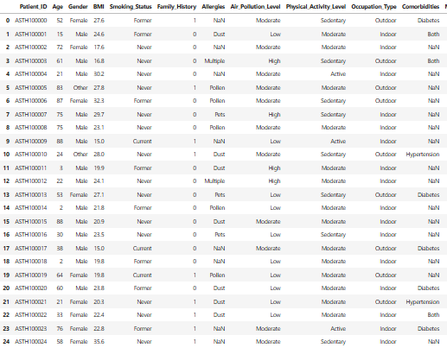
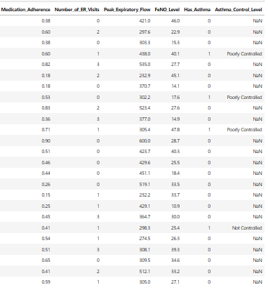
Data set

Slide 4
Objectives & problem statement
Objectives of the Project
• To understand the basic concept of asthma and its impact on the respiratory system. • To identify causes, symptoms, and triggers of asthma. • To study methods for diagnosis and management. • To create awareness about prevention and control of asthma. • To highlight the importance of early diagnosis and proper treatment.
Problem Statement
• Asthma is a common chronic respiratory disease affecting many people. • Lack of awareness and delayed diagnosis increase asthma complications. • Environmental pollution and allergens worsen asthma conditions. • Improper management of asthma can lead to severe health complications and reduced quality of life. • Proper understanding and management are needed to improve quality of life.

Slide 5
Dataset overview
• Patient_ID – A unique number used to identify each patient.
• Age – The age of the patient in years.
• Gender – Indicates whether the patient is Male, Female, or Other.
• BMI (Body Mass Index) – A value that shows whether a person is underweight, normal weight, or overweight.
• Smoking_Status – Shows the smoking habit of the patient.
Never – Has never smoked
Former – Smoked earlier but quit
Current – Still smokes

Slide 6
• Family_History – Shows whether asthma runs in the family.
1 – Yes
0 – No
• Allergies – Type of allergy the patient has, such as dust, pollen, pets, or multiple allergies.
• Air_Pollution_Level – Indicates how polluted the patient’s living area is.
Low – Clean air
Moderate – Some pollution
High – Heavy pollution that can trigger asthma
• Physical_Activity_Level – Shows how active the patient is.
Sedentary – Very little physical activity
Moderate – Some activity like walking
Active – Regular exercise or hard work
• Occupation_Type – Shows whether the patient mainly works indoors or outdoors.
• Comorbidities – Other health problems the patient has along with asthma, such as diabetes or hypertension.

Slide 7
• Medication_Adherence – Shows how regularly the patient takes asthma medicine.
Higher value – Medicine taken regularly
Lower value – Medicine often missed
• Number_of_ER_Visits – Number of times the patient visited the emergency room due to breathing or asthma problems.
• Peak_Expiratory_Flow (PEF) – Measures how fast a person can breathe out air.
High value – Lungs are working well
Low value – Breathing is difficult
• FeNO_Level – Measures swelling (inflammation) in the airways.
High value – More airway inflammation
Low value – Less inflammation and better control
• Has_Asthma – Shows whether the patient has asthma.
1 – Yes
0 – No

Slide 8
• Asthma_Control_Level – Shows how well asthma is controlled.
Well Controlled – Symptoms are under control
Poorly Controlled – Symptoms occur often
Not Controlled – Asthma is severe and unmanaged

Slide 9
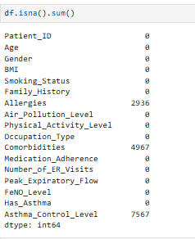
Data cleaning
• Data cleaning is the process of correcting or removing incorrect, incomplete, or unnecessary data from a dataset. • It helps to make the data clear, accurate, and ready for analysis.

Slide 10
Handling Missing Values in Allergies Column
• The Allergies column contained some missing values (NaN). • These missing values were filled using the most common allergy value (mode) in the dataset. • The mode represents the allergy type that appears most frequently among patients. • This method was chosen because Allergies is categorical data, and using the most common value keeps the data realistic.
Handling Missing Values in Comorbidities Column
• The Comorbidities column had some missing values (NaN). • These missing values were filled using the most common comorbidity (mode) in the dataset. • The mode represents the health condition that appears most frequently among patients. • This method was used because Comorbidities is categorical data. • Filling missing values ensures consistency and avoids problems during data analysis.

Slide 11
Handling Missing Values in Asthma_Control_Level Column
• The Asthma_Control_Level column had some missing values. • Patients were grouped based on their physical activity level (Sedentary, Moderate, Active). • In each group, the most common asthma control level was identified. • The missing values were filled using this common value from the same group. • This was done because patients with similar activity levels usually have similar asthma control. We use groupby because asthma control depends on physical activity, so values are filled group-wise.

Slide 12
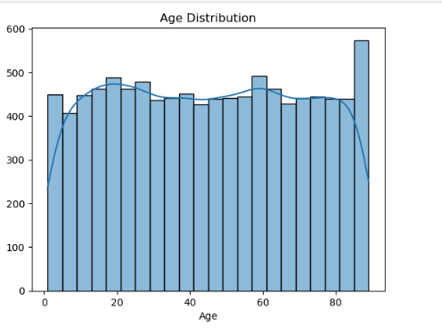
Data visualization
Age Distribution:
Interpretation:
• The graph shows the distribution of patients across different age groups. • The data shows that asthma affects people across all age groups. • This balanced age distribution helps in understanding asthma patterns in different age ranges.
Higher Y-value (taller bars) → More patients in that age group.

Slide 13
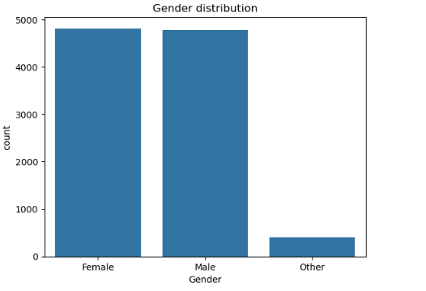
Gender Distribution
Interpretation:
• This graph shows the number of patients based on gender. • Male and female patients are present in almost eqal numbers • The other category has very few patients compared to male and female. • This indicates that asthma affects both males and females eqully

Slide 14
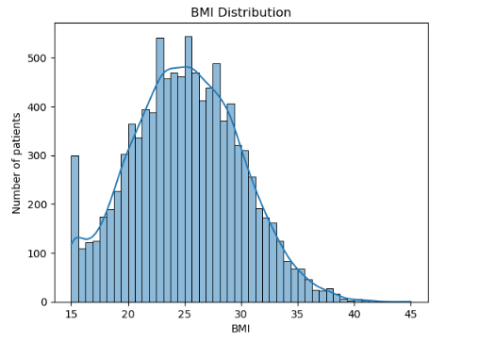
BMI Distribution
Interpretation:
• This graph shows how BMI valuesare spread among the patients. • Most patients have BMI values between 20 and 30 • The highest number of patients are around BMI 24-26, which is close to the normal range. • Very few patients have extremely low or very high BMI values. • Higher BMI values (above 30) may increase breathing difficulty and worsen asthma symptoms.

Slide 15
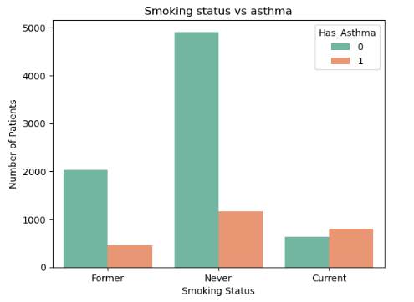
Smoking Status vs Asthma
Interpretation:
• This graph shows the relationship between smoking status and the presence of asthma. • Patients who never smoked form the largest group, but fewer of them have asthma. • current smokers show a higher proportion of asthma cases compared to non-asthma cases. • Former smokers also show a noticeable number of asthma cases. • This indicates that smoking increases airway irritation and raises the risk of asthma.
• As smoking exposure increases (from never to current smokers), the number of asthma patient increases, which raises the Y-value for asthma case.Smoking has a negative impact on lung health, and current smokers show more asthma cases compared to non-smokerss.

Slide 16
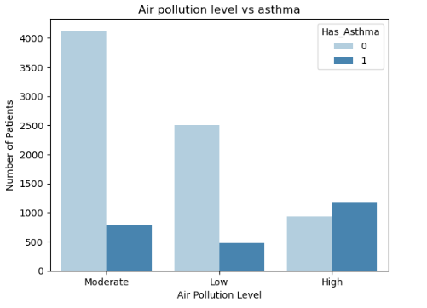
Air Pollution Level vs Asthma
Interpretation:
• This graph shows how the number of asthma patients changes across different air pollution levels. • Moderate pollution has the highest number of patients overall. • In the high pollution category, the asthma bar is taller than the non-asthma bar. • Low pollution areas show fewer asthma cases compared to moderate and high levels.
How Y-Value Is Affected: • The Y-value increases for asthma cases as the pollution level moves from low to high, showing more asthma patients in higher pollution categories.

Slide 17
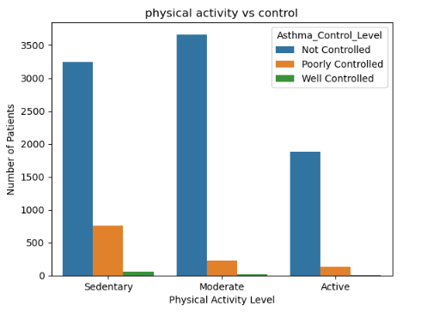
Physical Activity Level vs Asthma Control
Interpretation:
• This graph shows how asthma control levels change with different physical activity levels.
• Patients with a sedentary lifestyle have a higher number of not controlled and poorly controlled asthma cases. • Patients with moderatively active show better asthma control compared to sedentary patients. • Active patients have fewer poorly controlled asthma cases and more well-controlled cases. • This suggests that regular physical activity helps in better asthma management.
How Y-Value Affects the Graph: • As physical activity level improves from sedentary to active, the Y-value for poorly controlled cases decreases, while the Y-value for well-controlled cases increases.

Slide 18
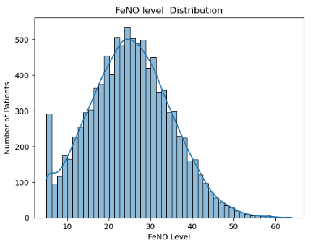
FeNO Level Distribution
Interpretation:
• FeNO indicates the level of inflammation in the airways (breathing tubes). • Most patients have FeNO levels between 20 and 30, which means mild to moderate airway inflammation. • Very few patients have extremely low or very high FeNO levels. • Higher FeNO values suggest increased airway irritation, which can worsen asthma symptoms.
How Y-Value Affects the Graph: • The Y-value increases when more patients have similar FeNO levels and decreases when fewer patients do.

Slide 19
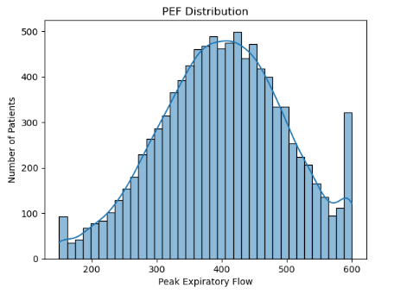
Peak Expiratory Flow (PEF) Distribution
Interpretation
• Peak Expiratory Flow (PEF) shows how fast a person can blow air out of their lungs. • Most patients have PEF values in the middle range, showing average breathing strength. • Very few patients have very low PEF values, which indicate weak airflow. • Higher PEF values mean better lung function and easier breathing. • Lower PEF values may be linked to poor asthma control.
How Y-Value Affects the Graph: • The Y-value increases where many patients have similar PEF values, making the bars taller, and decreases where fewer patients are present.

Slide 20
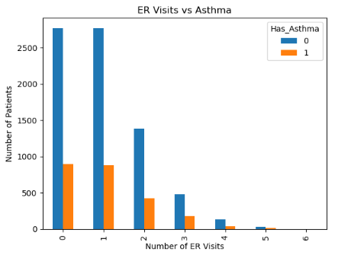
Number of ER Visits vs Asthma
Interpretation
• This graph shows how often patients visited the Emergency Room(ER) and whether they have asthma. • Most patients have 0 or 1 ER visit, showing fewer emergency situations. • Patients with asthma are more likely to have multiple ER visits compared to non-asthma patients. • As the number of ER visits increases, the number of patients decreases. • More ER visits usually indicate poor asthma control or severe symptoms.
How Y-Value Affects the Graph: • The Y-value shows the number of patients; it decreases as ER visits increase because fewer patients need frequent emergency care.

Slide 21
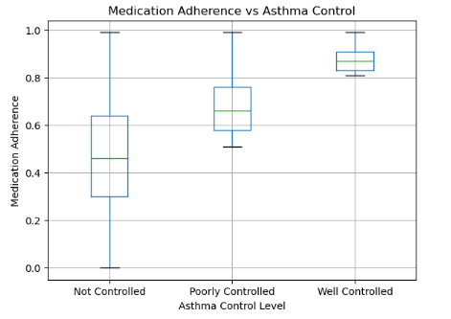
Medication Adherence vs Asthma Control
Interpretation
• This graph shows that regular medication use leads to better asthma control.
• Patients with not controlled asthma have lower medication adherence, meaning they do not take medicines regularly. • Patients with poorly controlled asthma take medicines more regularly than not controlled patients, but not consistently. • Patients with well controlled asthma have the highest medication adherence, meaning they follow their treatment properly. • This shows that taking asthma medication regularly helps in better asthma control.
How Y-Value Affects the Graph: • The Y-value shows medication adherence; higher Y-values mean medicines are taken more regularly, which is seen more in well-controlled asthma.

Slide 22
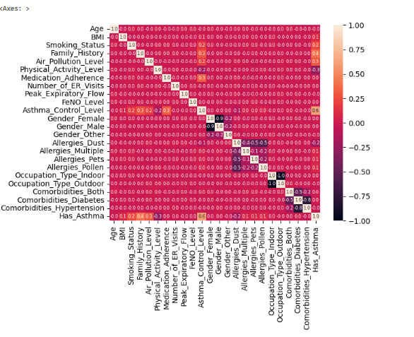
Correlation Heatmap:
• This heatmap shows how different columns in the dataset are related to each other. • Dark colors mean little or no relationship, and light colors mean stronger relationship.
• Values close to 0 mean there is little or no relationship.
• Values closer to 1 or -1 mean a strong relationship.
• Most variables show weak correlations, meaning they do not strongly depend on each other.
• Asthma-related factors like ER visits, medication adherence, and asthma control show some relationship with asthma presence.
• Demographic variables like age and gender show very little correlation with asthma.

Slide 23
encoding
Encoding is the process of converting categorical (text) data into numerical values.Machine learning models cannot understand text, so encoding is required. Encoding is an important data preprocessing step before model training.
Ordinal Encoding
• Ordinal encoding is used to convert ordered categorical column into numeric values.
• These columns follow a clear order (for example: low to high), so giving them ranked numbers helps keep this order meaningful and understandable for the model..
• It is applied to Physical Activity Level, Air Pollution Level, Smoking Status, and Asthma Control Level.
• Encoding is required because machine learning models works only with numerical data.
• This method keeps the correct order of the categories and helps the model understand which levels are lower or higher in severity.

Slide 24
One-Hot Encoding
• One-hot encoding is used to convert unordered categorical columns into numeric form.
• These columns do not have any natural order, so ranking them would be incorrect.
• It is applied to Gender, Allergies,Occupation Type, and comorbidities.
• Each category is converted into a separate binary column (0 or 1).
• This method prevents misleading relationships and improves model accuracy.
After applying ordinal and one-hot encoding, all categoricacal features were successfully converted into numerical values in a meaningful way. This makes the data ready to be used for building and training machine learning models in the next step.

Slide 25
Ml
◈ Machine Learning is a technique that enables systems to learn from data and make predictions automatically.
◈ It analyzes patterns and relationships present in the dataset.
◈ In this project, ML is used to predict whether a patient has asthma based on medical and lifestyle features.
◈ Using machine learning improves prediction accuracy and supports better analysis of medical data.
◈ Feature Selection
◈’ x ’ (Independent variables) include Age, Gender, BMI, Smoking Status, Family History, Allergies, Air Pollution Level, Physical Activity Level, Occupation Type, Comorbidities, Medication Adherence, ER Visits, Peak Expiratory Flow, and FeNO Level.
◈’ y ’ (Dependent variable) is Has_Asthma, which indicates whether a patient has asthma or not.

Slide 26
Models :
✓ Logistic Regression: Accuracy (0.93) shows the model predicts asthma using basic relationships in the data. It works well as a baseline model.
✓ Decision Tree: With accuracy (0.969), the model uses clear decision rules to predict asthma. It explains predictions using patient health factors.
✓ Random Forest: This model gives the highest accuracy (0.976) by combining many decision trees. It provides more accurate and stable predictions.
✓ K-Nearest Neighbors (KNN): Accuracy (0.976) shows good performance by comparing similar patients. Patients with similar features show similar asthma outcomes.
✓ Support Vector Classifier (SVC): SVC separates asthma and non-asthma cases using a decision boundary. It achieves an accuracy of (0.9475).

Slide 27
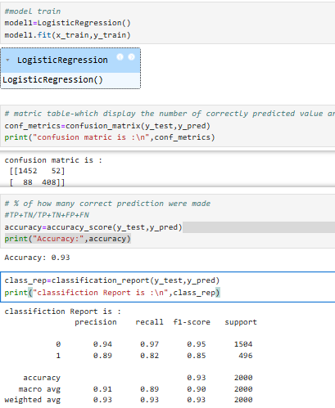
1. Logistic Regression
• This model gives a good accuracy(0.93) by learning basic relationships between patient health features.
• Predicted values are reliable and suitable for asthma prediction.
• Confusion Matrix: Correct approvals (TP):≥ 80% Correct rejections (TN): ≥ 90% Wrong approvals (FP): Almost low Wrong rejections (FN): Almost low
• Classification Report: Precision ≥ 0.90 Recall ≥ 0.82 F1-score ≥ 0.88

Slide 28
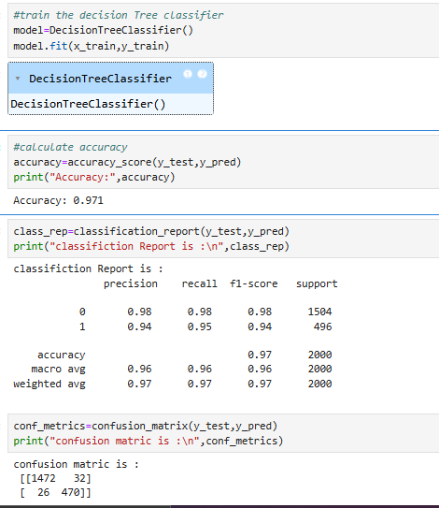
2. Decision Tree Classifier
• This model gives high accuracy (0.971) by learning clear decision rules from the data.
• It makes predictions based on important feature splits, giving understandable results.
• Confusion Matrix: Correct approvals (TP): ≥ 94–95% Correct rejections (TN): ≥ 98% Wrong approvals (FP): Almost low Wrong rejections (FN): Almost low
• Classification Report: Precision ≥ 0.96 Recall ≥ 0.96 F1-score ≥ 0.96

Slide 29
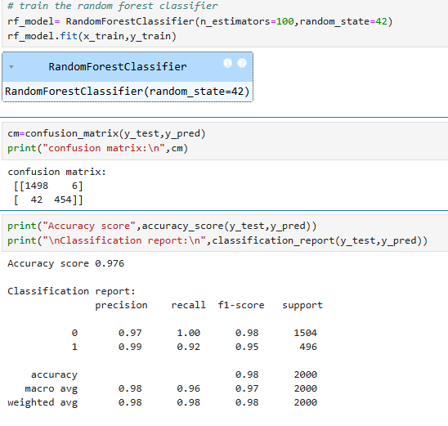
3.Random Forest Classifier
• This model gives high accuracy (0.976) by combining multiple decision trees, making predictions more stable and reliable.
Confusion Matrix:
TP (454): Patient has asthma and predicted has asthma
TN (1498): Patient does not have asthma and predicted does not have asthma
FP (6): Patient does not have asthma but predicted has asthma
FN (42): Patient has asthma but predicted does not have asthma
Classification Report:
Precision ≥ 0.98
Recall ≥ 0.92
F1-score ≥ 0.95

Slide 30
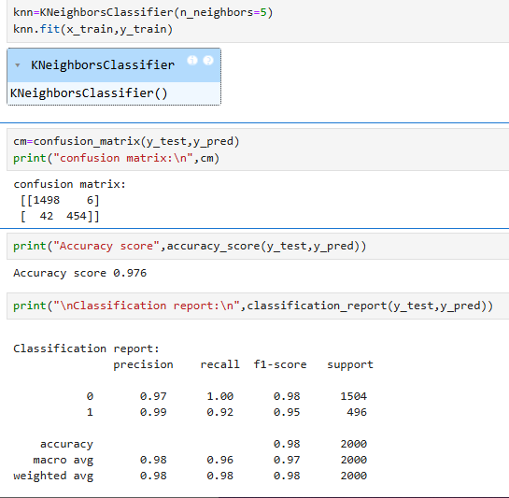
4. K-Nearest Neighbors (KNN) Classifier
• This model predicts asthma by looking at the nearest similar patients, giving high accuracy (0.976).
Confusion Matrix:
TP (454): Patient has asthma and predicted has asthma
TN (1498): Patient does not have asthma and predicted does not have asthma
FP (6): Patient does not have asthma but predicted has asthma
FN (42): Patient has asthma but predicted does not have asthma
Classification Report:
Precision ≥ 0.98
Recall ≥ 0.92
F1-score ≥ 0.95

Slide 31
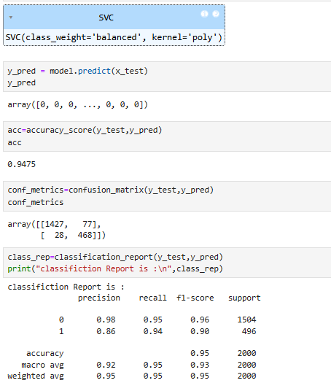
5. Support Vector Classifier (SVC)
• This model separates patients into asthma and no asthma groups by finding the best boundary, giving good accuracy (0.9475).
Confusion Matrix:
TP (468): Patient has asthma and predicted has asthma
TN (1427): Patient does not have asthma and predicted does not have asthma
FP (77): Patient does not have asthma but predicted has asthma
FN (28): Patient has asthma but predicted does not have asthma
Classification Report:
Precision ≥ 0.95
Recall ≥ 0.94
F1-score ≥ 0.93

Slide 32
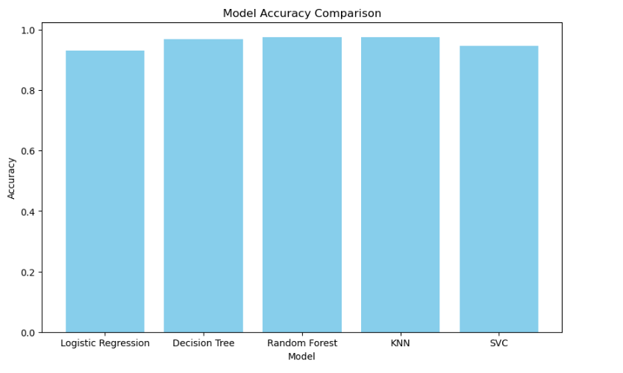
Model Accuracy Comparison – Interpretation
• This bar graph compares the accuracy of different ML models used for asthma prediction. • The Y-axis represents accuracy, showing how correctly each model predicts asthma. • Logistic Regression has the lowest accuracy but works as a baseline model. • Decision Tree shows improved accuracy by learning decision rules. • Random Forest and KNN achieve the highest accuracy, giving the best performance. • SVC performs well but slightly lower than Random Forest and KNN.
Conclusion: • Random Forest and KNN are the most reliable models for this project.

Slide 33
Project conclusion
• Asthma patient data was analyzed using data cleaning, encoding, and visualization techniques.
• Key factors such as age, BMI, smoking status, air pollution, physical activity, FeNO level, and lung function were studied.
• Multiple machine learning models were used to predict whether a patient has asthma.
• Random Forest and KNN achieved the highest accuracy, providing reliable predictions.
• Proper data preprocessing and encoding played a major role in improving model performance.
• Visualizations helped in understanding patterns and relationships in asthma-related data.
• This project shows how machine learning can support early asthma detection and decision-making.
• The results show that machine learning is effective for asthma prediction and analysis.
• The project can be enhanced further using more clinical data and advanced models to support healthcare decisions.

Slide 34
Thank You!

